Slide 1


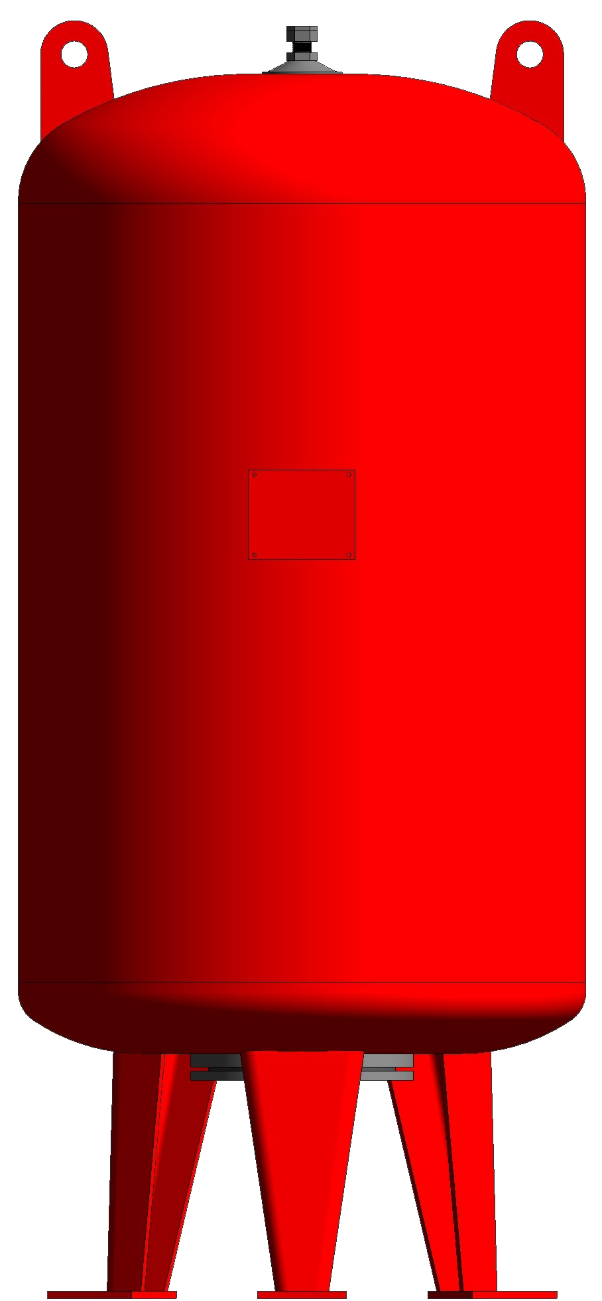

PRODUCT CATALOGUE
EXPANSION VESSELS

Slide 2

EXPANSION VESSELS
MEMBRANE WATER TANKS
The bladder water tank is a necessary element for a long lasting and regularly working potable water distribution system. Its function is to increase the pressure with which the aqueduct water reachers the end-user. The water tank moderates the changes of pressure gathing the exceeded pressure to optimize the work of the pump. BAOLA water tanks are suited for all types of water systems: industrial, home, and agricultural. BAOLA bladder are balloon-shaped and are directly attached to the flange, avoiding any contact between water and the metal surfaces of the tank. Furthemore, the introduction of the membrane after tank painting preserver its elasticity,
impermeability and non-toxicity. BAOLA not only produces its metal tanks, but also the rubber bladder, thanks to an exclusive know-how, and for most ranges produces the rubber compound too, so maintains under its control the most important component of the pressure tanks
TECHNICAL DATA
Applications:
Water booster systems Irrigation systems Residential and commercial well water Fire fighting systems Chiller water systems
Material:
Shell: Carbon steel.
Membrane: EDPM, IIR
Test pressure:
1,5 times the max. working pressure
Working Temperature:
Maximum temperature: +90°C
Minimum temperature: -10°C
Color:
Red

Slide 3
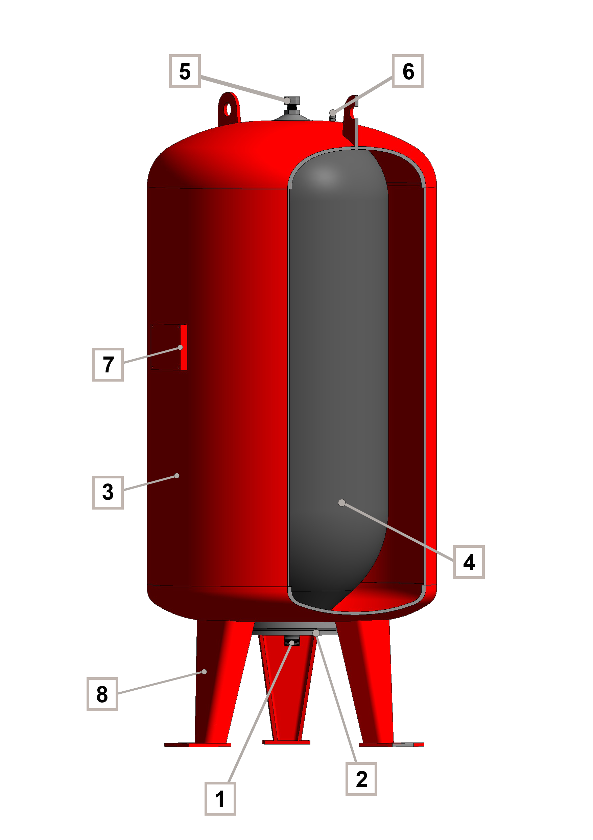
EXPANSION VESSELS
ORGANIZE
1 System connection
2 Flange
3 Shell
4 Membrane
5 Precharge valve
6 Top support fitting
7 Pump bearing plate
8 Legs

Slide 4
EXPANSION VESSELS
EXPANSION TANK
H
D
Expansion tank/ Pmax 6bar.
MODEL | VN (l) | D (mm) | H (mm) | S (inch)
GN50-6 | 50 | 379 | 689 | 1
GN60-6 | 60 | 379 | 755 | 1
GN100-6 | 100 | 450 | 840 | 1
GN200-6 | 200 | 554 | 1180 | 1 1/2
GN300-6 | 300 | 624 | 1300 | 1 1/2
GN500-6 | 500 | 790 | 1390 | 1 1/2
GN750-6 | 750 | 786 | 1855 | 1 1/2
GN1000-6 | 1000 | 945 | 1842 | 2
GN1250-6 | 1250 | 1020 | 1842 | 2
GN1500-6 | 1500 | 1150 | 2010 | 2
GN2000-6 | 2000 | 1280 | 2010 | 2
GN2500-6 | 2500 | 1150 | 2640 | 2
GN3000-6 | 3000 | 1250 | 2640 | 2
Expansion tank/ Pmax 10bar.
MODEL | VN (l) | D (mm) | H (mm) | S (inch)
GN50-10 | 50 | 379 | 689 | 1
GN60-10 | 60 | 379 | 755 | 1
GN100-10 | 100 | 450 | 840 | 1
GN200-10 | 200 | 554 | 1180 | 1 1/2
GN300-10 | 300 | 624 | 1300 | 1 1/2
GN500-10 | 500 | 790 | 1390 | 1 1/2
GN750-10 | 750 | 786 | 1855 | 1 1/2
GN1000-10 | 1000 | 945 | 1842 | 2
GN1250-10 | 1250 | 1020 | 1842 | 2
GN1500-10 | 1500 | 1150 | 2010 | 2
GN2000-10 | 2000 | 1280 | 2010 | 2
GN2500-10 | 2500 | 1150 | 2640 | 2
GN3000-10 | 3000 | 1250 | 2640 | 2

Slide 5
EXPANSION VESSELS
Expansion tank/ Pmax 16bar.
MODEL | VN (l) | D (mm) | H (mm) | S (inch)
GN50-16 | 50 | 379 | 689 | 1
GN60-16 | 60 | 379 | 755 | 1
GN100-16 | 100 | 450 | 840 | 1
GN200-16 | 200 | 554 | 1180 | 1 1/2
GN300-16 | 300 | 624 | 1300 | 1 1/2
GN500-16 | 500 | 790 | 1390 | 1 1/2
GN750-16 | 750 | 786 | 1855 | 1 1/2
GN1000-16 | 1000 | 945 | 1842 | 2
GN1250-16 | 1250 | 1020 | 1842 | 2
GN1500-16 | 1500 | 1150 | 2010 | 2
GN2000-16 | 2000 | 1280 | 2010 | 2
GN2500-16 | 2500 | 1150 | 2640 | 2
GN3000-16 | 3000 | 1250 | 2640 | 2
Expansion tank/ Pmax 20bar.
MODEL | VN (l) | D (mm) | H (mm) | S (inch)
GN50-20 | 50 | 379 | 689 | 1
GN60-20 | 60 | 379 | 755 | 1
GN100-20 | 100 | 450 | 840 | 1
GN200-20 | 200 | 554 | 1180 | 1 1/2
GN300-20 | 300 | 624 | 1300 | 1 1/2
GN500-20 | 500 | 790 | 1390 | 1 1/2
GN750-20 | 750 | 786 | 1855 | 1 1/2
GN1000-20 | 1000 | 945 | 1842 | 2
GN1250-20 | 1250 | 1020 | 1842 | 2
GN1500-20 | 1500 | 1150 | 2010 | 2
GN2000-20 | 2000 | 1280 | 2010 | 2
GN2500-20 | 2500 | 1150 | 2640 | 2
GN3000-20 | 3000 | 1250 | 2640 | 2
Expansion tank/ Pmax 25bar.
MODEL | VN (l) | D (mm) | H (mm) | S (inch)
GN50-25 | 50 | 379 | 689 | 1
GN60-25 | 60 | 379 | 755 | 1
GN100-25 | 100 | 450 | 840 | 1
GN200-25 | 200 | 554 | 1180 | 1 1/2
GN300-25 | 300 | 624 | 1300 | 1 1/2
GN500-25 | 500 | 790 | 1390 | 1 1/2
GN750-25 | 750 | 786 | 1855 | 1 1/2
GN1000-25 | 1000 | 945 | 1842 | 2
GN1250-25 | 1250 | 1020 | 1842 | 2
GN1500-25 | 1500 | 1150 | 2010 | 2
GN2000-25 | 2000 | 1280 | 2010 | 2
GN2500-25 | 2500 | 1150 | 2640 | 2
GN3000-25 | 3000 | 1250 | 2640 | 2

Slide 6
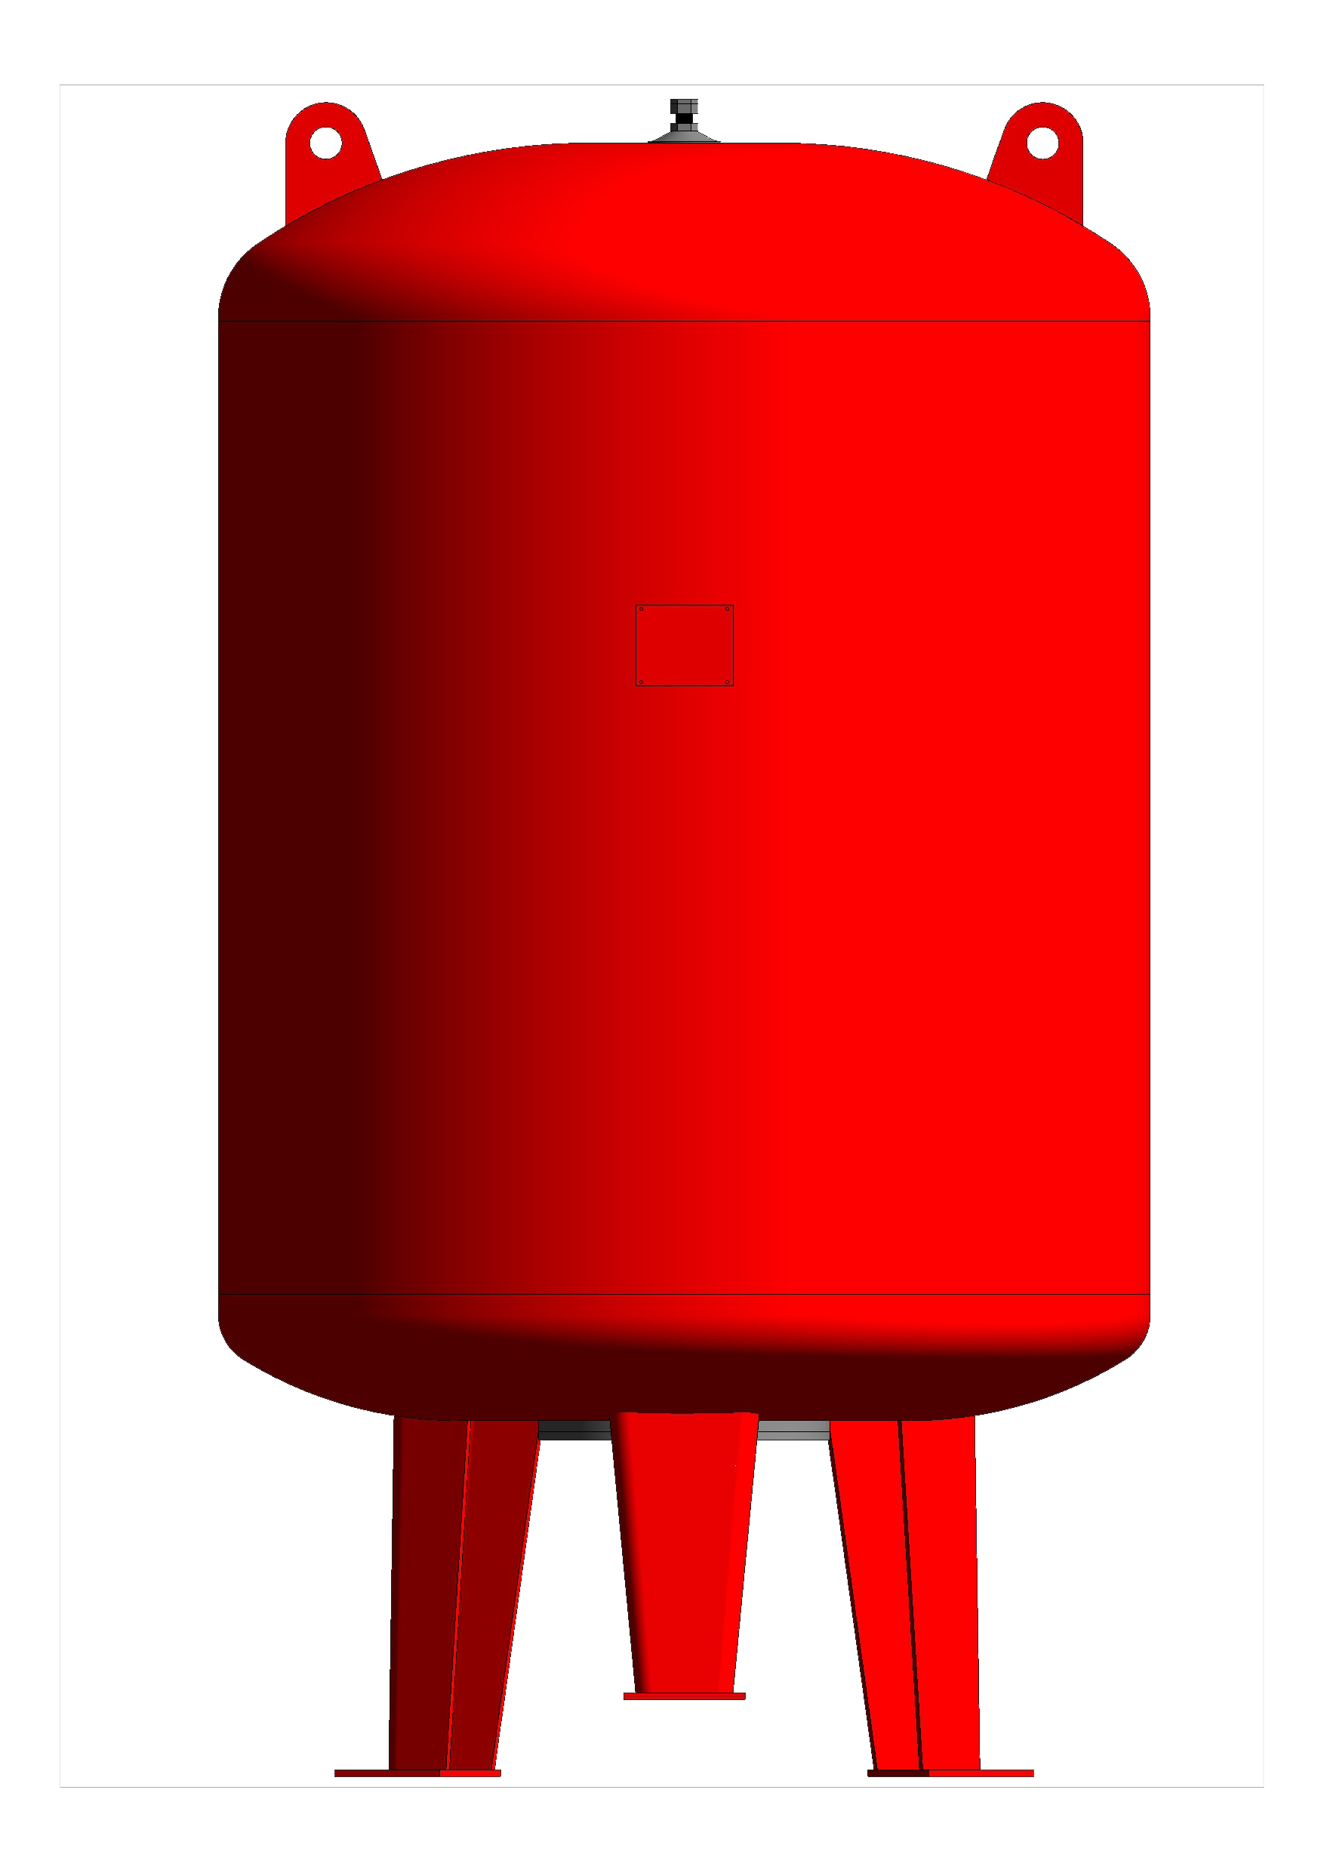
MAIN TANK (FOR PRESSURIZATION SYSTEM)
MAIN TANK
H
D
Main tank/ Pmax 2bar.
MODEL | VN (l) | D (mm) | H (mm) | S (inch)
TMT50 | 50 | 379 | 689 | 3/4
TMT60 | 60 | 379 | 755 | 3/4
TMT80 | 80 | 450 | 719 | 3/4
TMT100 | 100 | 450 | 840 | 3/4
TMT150 | 150 | 554 | 970 | 3/4
TMT200 | 200 | 554 | 1180 | 3/4
TMT300 | 300 | 624 | 1300 | 3/4
TMT500 | 500 | 790 | 1390 | 3/4
TMT750 | 750 | 765 | 1935 | 3/4
TMT800 | 800 | 790 | 1935 | 3/4
TMT900 | 900 | 838 | 1935 | 3/4
TMT1000 | 1000 | 883 | 1935 | 3/4
TMT1100 | 1100 | 926 | 1935 | 3/4
TMT1200 | 1200 | 967 | 1935 | 3/4
TMT1300 | 1300 | 1007 | 1935 | 3/4
TMT1400 | 1400 | 1045 | 1935 | 3/4
TMT1500 | 1500 | 1082 | 1935 | 3/4
TMT1600 | 1600 | 1117 | 1935 | 3/4
TMT1700 | 1700 | 1151 | 1935 | 3/4
TMT1800 | 1800 | 1185 | 1935 | 3/4
TMT1900 | 1900 | 1217 | 1935 | 3/4
TMT2000 | 2000 | 1249 | 1935 | 3/4
TMT2500 | 2500 | 1249 | 2200 | 3/4
TMT3000 | 3000 | 1250 | 2640 | 3/4

Slide 7

BAOLA PRODUCTION PROMOTION & TECHNOLOGIES INC.,
Address: 2035B av.Victoria Saint-Lambert (Québec),J4S1H1, Canada
Website : www.baolaco.net
Email : infor@baolaco.net

